Slide 1
Energy Efficiency

Slide 2
Objective :-
Buildings energy consumption is put away around 40% of total energy use. Predicting heating and cooling loads of a building in the initial phase of the design to find out optimal solutions amongst different designs is very important, as well as in the operating phase after the building has been finished for efficient energy. In this project, different models were applied for predicting heating and cooling loads of a building based on a dataset for building energy performance.

Slide 3
Data Sharing Agreement :-
Sample file name (ex ENB_2012)
Length of Year (4digit)
Number of Columns
Column names
Column data type

Slide 4
ARCHITECTURE
Start
Data from Client
Data Insert Into
Database
Start
Data
Enter Into DB
Get From DB
Pushing App to Cloud
Cloud Setup
Model Building
Data Pre-Processing
Application Start
Data from User
Model Calling
Data Validation
END
Prediction

Slide 5
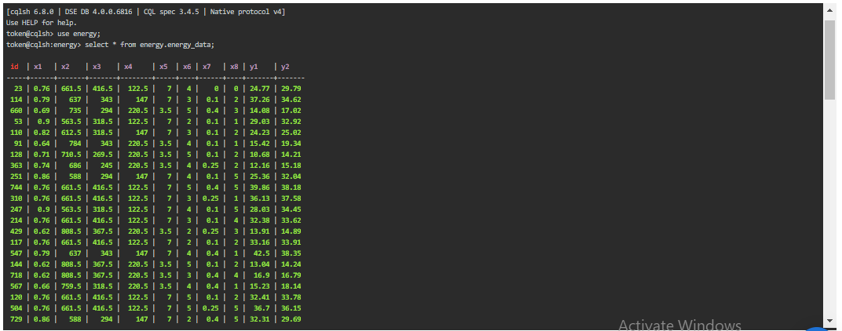
Data Insertion in Database:
Table creation : Table name “energy_data" is created in the key space having name “energy” for inserting the files. If the table is already present then new files are inserted in the same table.
Insertion of files in the table : All the files in the are inserted in the above-created table. If any file has invalid data type in any of the columns, the file is not loaded in the table

Slide 6
Data Preprocessing :
In data preprocessing lot off step’s are included, but in that we use some of them. The reason behind that we don’t have any missing value or categorical column.
Column Name : In that case we just name the column name we their original name such as
X1 | Relative Compactness | X6 | Orientation
X2 | Surface Area | X7 | Glazing Area
X3 | Wall Area | X8 | Glazing Area Distribution
X4 | Roof Area | Y1 | Heating Load
X5 | Overall Height | Y2 | Cooling Load

Slide 7
Model Building :-
Normalization : In these case we normalize all feature value except the target value. So that all the feature value come in one range. In that case we use MinMax Scalar in which value vary between 0 to 1.
PCA : Principal component analysis (PCA) is a technique for reducing the dimensionality of such datasets, increasing interpretability but at the same time minimizing information loss. It does so by creating new uncorrelated variables that successively maximize variance.
Splitting Data : In these case we split up the data into train and test set. In which test size will be 33% of full dataset.
Build Model : In these case we use two model as per our problem statement.
1] Linear Regression
2] Random Forest

Slide 8
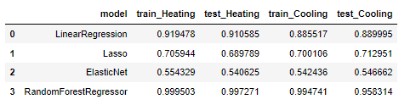
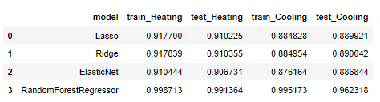
Models Accuracy :-
Before Hyper Parameter Tuning
After Hyper Parameter Tuning

Slide 9
Q & A
Q1) What’s the source of data?
The data for training is provided by the client .
Q 2) What was the type of data?
The data type is numerical in nature.
Q 3) What’s the complete flow you followed in this Project?
Refer slide 4th for better Understanding
Q 4) How logs are managed?
We are using different logs as per the steps that we follow in, Data Insertion, Model Training log , prediction log etc.

Slide 10
Q 6) What techniques were you using for data pre-processing?
We don’t use many technique because there is no need of that except the Normalization
Q 7) How training was done or what models were used?
1] Before diving the data in training and testing set we performed scaling operation on the training and testing set.
2] Algorithms like Linear Regression & RF were used to find out the accuracy.
Q 8) What are stage for deployment?
1] The 1st stage is to create your app.py file so that we can see our model.
2] The 2nd stage is to update your project on GitHub.
3] The 3rd stage in which you can deploy your model on any server such as GCP, AWS, Azure

Slide 11
THANK YOU

